Slide 1

Workshop on Cloud Computing
Department of MCA,
Siddaganga Institute of Technology, Tumkur
By Ankit Velani, Rajeev H R

Slide 2

Agenda
1
Cloud Computing Fundamentals
Understand the core concepts of cloud computing.
2
Getting Started with Azure
Create your Azure account, explore Subscriptions and Resource Groups.
3
Virtual Machines in Azure
Learn to deploy, access, and manage VMs. Host web pages and applications.
4
Azure Services in Action
Work with MySQL databases, BLOB storage, and Azure App Services.
5
Hands-On Lab & Q&A
Apply your knowledge in guided practice sessions and get your questions answered.

Slide 3
Network (N/w)
1

Slide 4
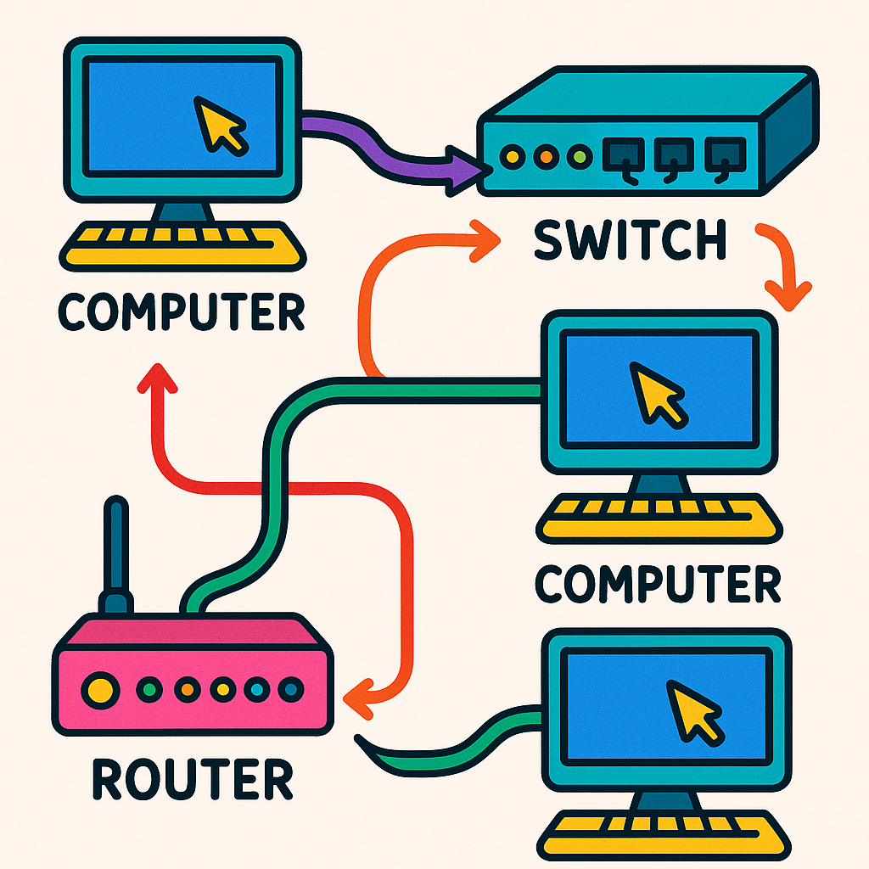
Network
A network is a system of interconnected devices that can communicate and share resources with each other.
Think of it like a group of friends passing notes to each other — each person (device) is connected and can send or receive messages.

Slide 5

Internet
WAN (Wide Area Network)
WAN (Wide Area Network) is a type of computer network that covers a large geographic area, such as a city, country, or even the entire world.
Internet is a global network that connects millions of computers and devices, allowing them to communicate, share information, and access websites and services from anywhere in the world.

Slide 6
How to access device Globally ?
Public IP Address
Domain (www.example.com)
From Anywhere to Everywhere — Stay Connected
Port Forwarding
Port Forwarding

Slide 7
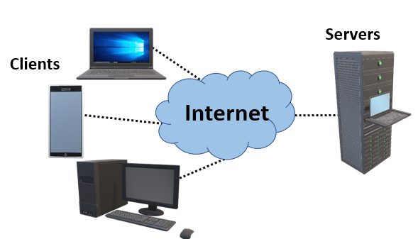
What is a Server ?
A server is a computer or system that provides resources, services, or data to other computers, called clients, over a network.
Common Types of Servers
Web Server – Delivers websites (like Google, YouTube)
File Server – Stores and shares files
Database Server – Handles data storage and queries
Mail Server – Sends and receives emails

Slide 8
What’s our approach to maintaining the server?
Physically
Virtually
At home
At office
At College
At Hospitals
Virtually manage from Service Provider

Slide 9
Service Providers
Shared Services
Cloud Services
Azure
AWS
GCP
Adobe
Salesforce
IBM
Alibaba
DigitalOcean
GoDaddy
Bluehost
DreamHost
Hostinger
Hostwinds
IONOS

Slide 10




What is Cloud Computing ?
Cloud computing is the delivery of computing services—like servers, storage, databases, networking, software, and more—over the Internet ("the cloud") instead of your local computer or personal data center.
Servers
Storage
Databases
Networking

Slide 11
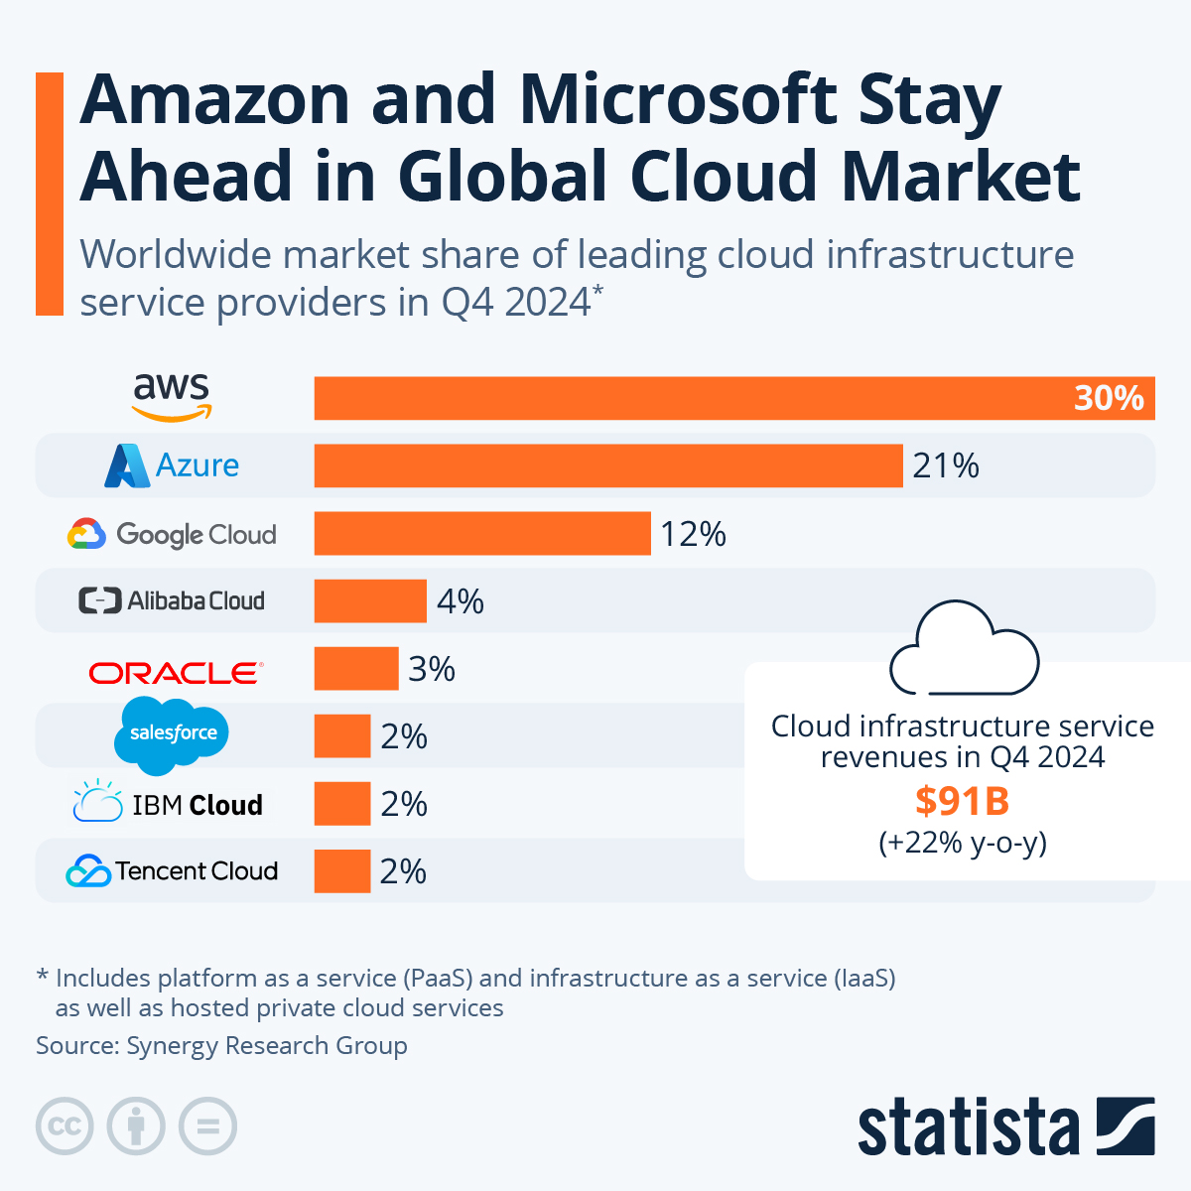

Slide 12

What is Azure ?

Slide 13
What is Azure ?
Microsoft Cloud Platform
Microsoft Azure is a cloud computing platform created by Microsoft. It provides a wide range of services that help individuals and businesses build, deploy, and manage applications through Microsoft's global network of data centers.
Think of Azure as:
A massive online toolbox where you can rent computing power, storage, databases, and more—without needing to own physical servers.

Slide 14
Key Features of Azure
1
Compute
Run virtual machines, containers, and apps
2
Storage
Save files, databases, and backups securely
3
Networking
Connect services and users across the globe
4
AI & Machine Learning
Build intelligent apps with built-in tools.
5
Security
Protect data with enterprise-grade security and compliance.

Slide 15
Key Features of Azure
1
Compute
Run virtual machines, containers, and apps
2
Storage
Save files, databases, and backups securely
Real-World Example:
A retail company uses Azure to host its website, store customer data, and analyze shopping trends using AI—all without owning a single physical server.
3
Networking
Connect services and users across the globe
4
AI & Machine Learning
Build intelligent apps with built-in tools.
5
Security
Protect data with enterprise-grade security and compliance.

Slide 16
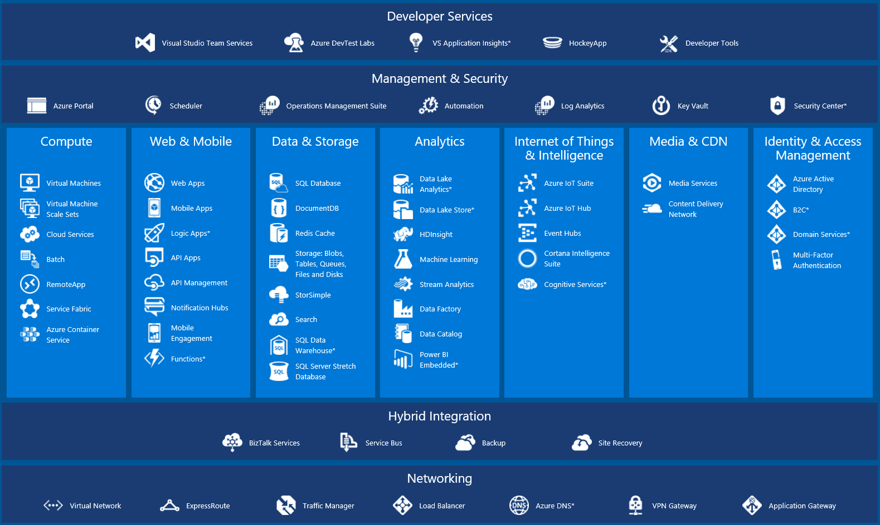

Slide 17
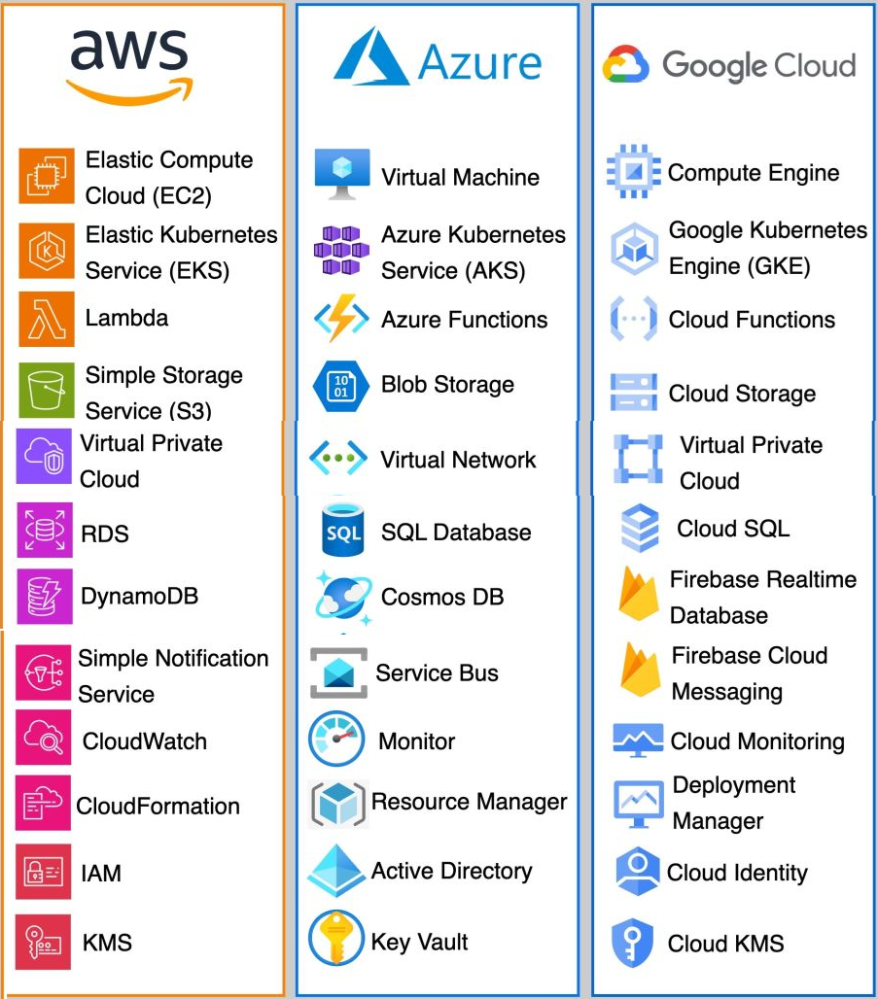

Slide 18
Bootcamp Objective
Virtual Machine
Blob Storage
SQL Databases
App Services

Slide 19
Bootcamp Use case
Sing Up on Azure
Host Static Website
Host Dynamic Website
Steps :
1
2
3

Slide 20
Getting Started with Azure
2

Slide 21
Azure for Students – Free Account Credit
Please follow the steps outlined in the document available at the link below. Download the file to proceed
Download Now
or
https://github.com/mcasit/mcasit.github.io/blob/main/AZURE/1.AZURE_FOR_STUDENTS_FREE_ACCOUNT_CREDIT.pdf

Slide 22
Azure Active Directory (AAD)
Subscription-1
Region (Location)
Resource Group
Resource
Tags
Subscription-2
Region(Location)
Resource Group
Resource
Tags
Azure Fundamentals: Structuring Your Cloud Environment

Slide 23
Users -> Staff, Faculty, Students
Azure Active Directory (AAD)
Subscription-1
Region (Location)
Resource Group
Resource
Tags
Subscription-2
Region(Location)
Resource Group
Resource
Tags
Colleges Subscription
Location to store data
Departments -> MCA, MBA, CS
Classrooms, Labs, Seminar halls
Batch-2024-2026
HOD

Slide 24
Virtual Machines
3

Slide 25
Databases
4

Slide 26
Azure Databases
Azure offers a wide range of database services tailored for different needs—whether you're building web apps, enterprise systems, or analytics platforms. Here's a quick overview of the main types of Azure Databases.
1. Relational
2. Non-Relational
3. Data Warehouse
Azure SQL (SQL Server) Database
Azure Database for PostgreSQL
Azure Database for MySQL
Azure Database for MariaDB
Oracle Database@Azure
Azure Cosmos DB
MongoDB
Azure Table Storage
Azure Synapse Analytics

Slide 27

Azure Database for MySQL
The world's most popular open-source database
Azure Database for MySQL is a fully managed relational database service based on the open-source MySQL Community Edition. It handles maintenance, backups, scaling, and security—so you can focus on building your applications.
Key Features:
✅ Managed Service: No need to manage infrastructure or updates.
🔐 Built-in Security: Data encryption at rest and in transit.
📈 Scalability: Scale compute and storage independently.
♻️ High Availability: Automatic failover and backups.
💡 Flexible Pricing: Pay-as-you-go or reserved capacity.

Slide 28
Azure Database for MySQL
Please follow the steps outlined in the document available at the link below. Download the file to proceed
----Download Now
or
------- actual UAT

Slide 30
Storage
5

Slide 31
App Services
6

Slide 32
Practice time
7

Slide 33
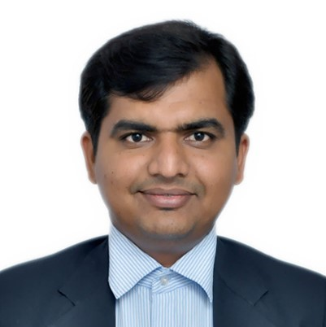
Thank you!
Ankitkumar Velani
ankit.velani@gmail.com
linkedin.com/in/ankitvelani
+91-99866 38148
Rajeev H R
ankit.velani@gmail.com
linkedin.com/in/ankitvelani
+91-99866 38148

